Slide 1
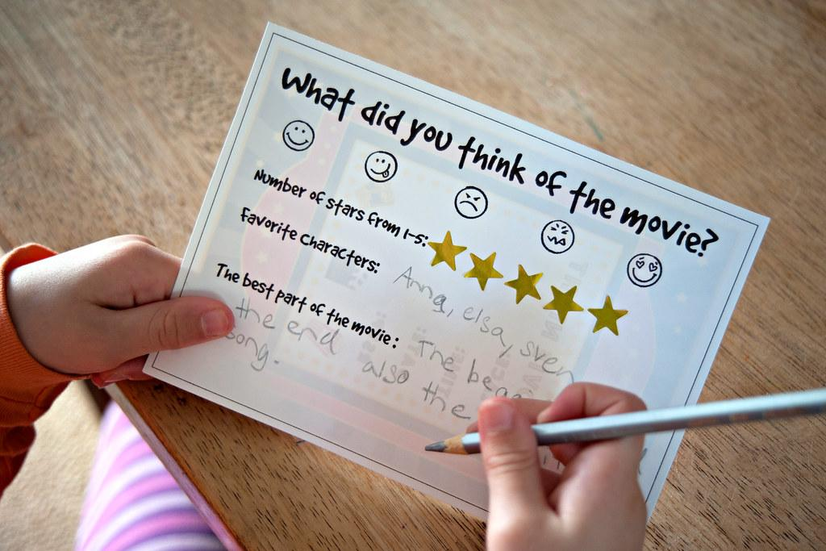
Movie Sentiment Analysis
By: Gurpratap Singh, Troy Prata, Tyler Gehbauer, Brian Lui

Slide 2
Introduction
We are doing a Movie Sentiment Analysis where we are taking a dataset containing movie reviews that are labeled as a positive or negative review. This dataset been prepared and tested by Stanford University, where they created a model where it gave 100% accuracy when finding if a movie review is positive or negative. We are using multiple deep learning techniques on our end to try to find which model can most accurately predict and compare the accuracy to the actual sentiment that Stanford has produced. We are using the LSTM and the AdaBoost classifier for an analysis on word count in the reviews. We are using PyCaret for topic modeling,which is an analysis on topics in the movie reviews. Later we will ask the class in the main Slack chat to pick a movie for us to run our model on to see if our model could predict if it would be a positive or negative review.

Slide 3
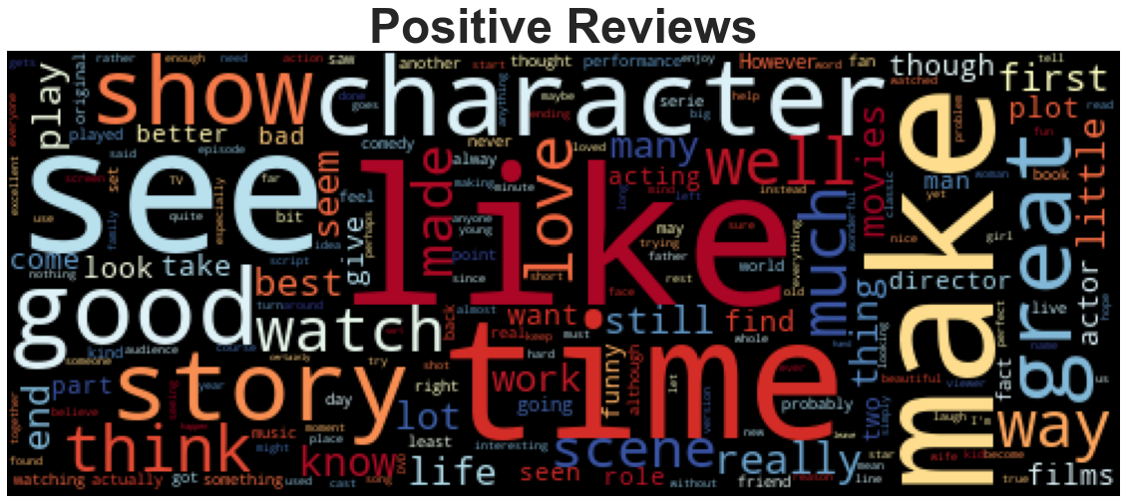
Positive Reviews
Good
Time
Best
Funny
Great
Love
Enjoy
Notes:
We took the VADER score, if the compound score where if the compound score was positive, it would be a positive review and if it was a negative compound score we included that in the negative review word cloud

Slide 4
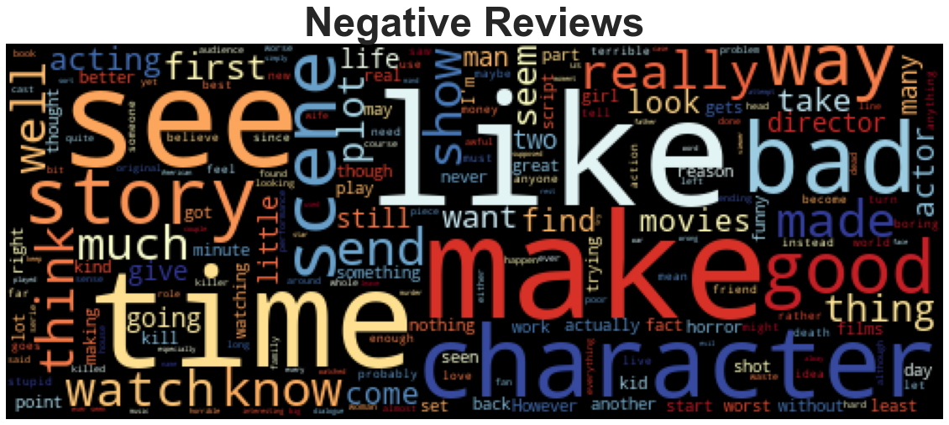
Negative Reviews
Bad
Many
Kill
Acting
Horror
Worst
Least
Notes:
But there were still a lot of words that were both in a negative and positive movie review

Slide 5
LSTM Model
Reason why we used LSTM as one of our models is because there are a lot of common words in both the negative and positive movie reviews. With a traditional RNN (Recurrent Neural Networks), the memory is limited and cannot contain memory for long periods of time. LSTM solves RNN’s problem by producing new gates for long-term temporal dependencies.
With LSTM, it can have multiple temporal dependencies with different weights to help the model differentiate between a positive and negative review

Slide 6
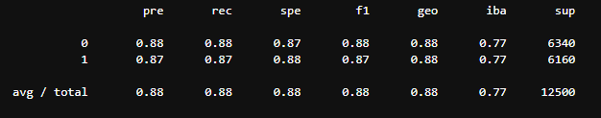
LSTM Classification Report
Notes:
We have a pretty good precision score where our model is only giving about 12% chance of a false negative review and 13% chance of a false positive review
Our F1 score is also pretty high meaning our model had a good accuracy in predicting correct positive and negative reviews

Slide 7
AdaBoost
An AdaBoost classifier is a meta-estimator that begins by fitting a classifier on the original dataset and then fits additional copies of the classifier on the same dataset but where the weights of incorrectly classified instances are adjusted such that subsequent classifiers focus more on difficult cases.
In case of AdaBoost, it minimises the exponential loss function that can make the algorithm sensitive to the outliers. With Gradient Boosting technique, any differentiable loss function can be utilised. Gradient Boosting algorithm is more robust to outliers than AdaBoost. From our word clouds, we felt that we did not have many outliers since our word clouds showed that we had similar words in both a positive and negative movie review.

Slide 8
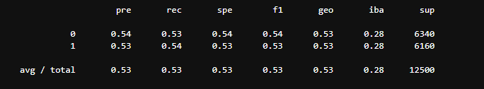
AdaBoost Classification Report
Notes:
Low precision score

Slide 9
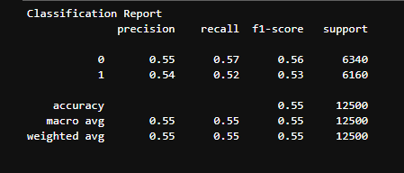
Gradient Boost Classification Report
Notes:
Since the AdaBoost Classification report did not show high accuracy, we decided to try gradient boost model, however not much of a difference from the Ada Boost Classification Report

Slide 10
PyCaret
PyCaret is a machine learning library which we used for Topic Modeling. Topic Modeling is a type of statistical model for discovering the abstract “topics” that occur in a collection of documents, in this case, movie reviews.
There are 2 steps to Topic Modeling:
Topic to Term Distribution: Finding the most important topics in the corpus
Document to Topic Distribution: Assigning scores of each topic to each document
Notes:
Topic Modeling is basically an unsupervised machine learning technique that's capable of scanning a set of documents, detecting word and phrase patterns within them, and automatically clustering word groups and similar expressions that best characterize a set of documents

Slide 11
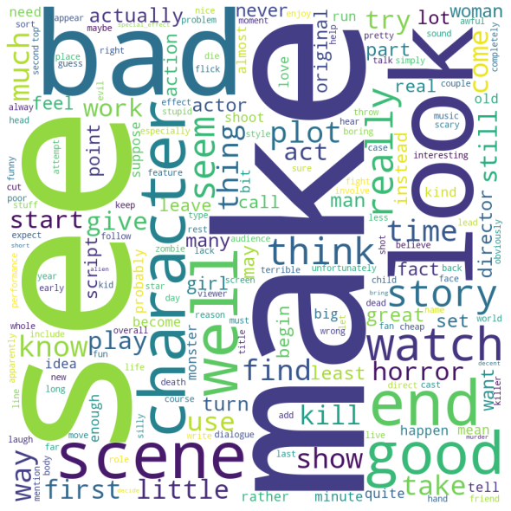
Inter-Topic Modeling Word Cloud

Slide 12
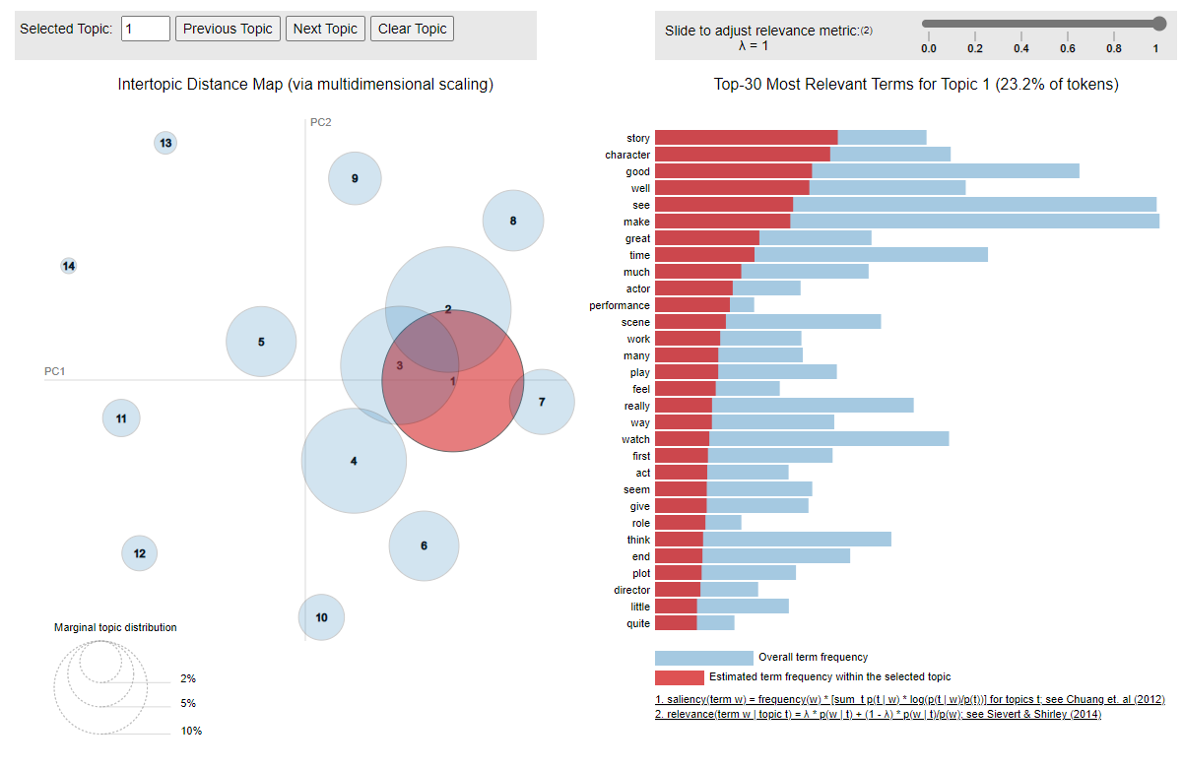
Intertopic Distance Map
Notes:
The intertopic distance map is a visualization of the topics in a two-dimensional space .
The area of these topic circles is proportional to the amount of words that belong to each topic across the dictionary.
The circles are plotted using a multidimensional scaling algorithm (converts a bunch of dimension, more than we can conceive with our human brains, to a reasonable number of dimensions, like two) based on the words they comprise, so topics that are closer together have more words in common.

Slide 13
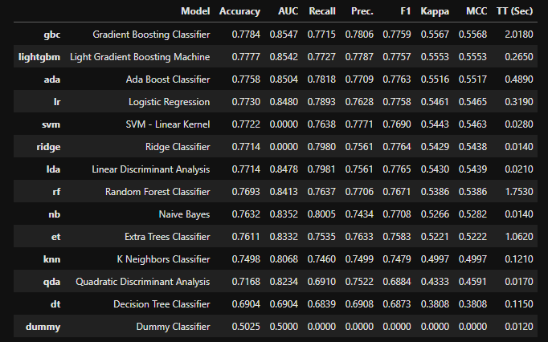
Best Model Comparison in PyCaret

Slide 14
Conclusion
For our word count analysis, the LSTM Model was the most accurate in predicting positive and negative reviews.
For our topic modeling analysis, the most accurate deep learning model was Gradient Boost Classifier
Notes:
LSTM
Over 87% of the predictions were correct on whether a review was positive or negative review.
PyCaret
It had the highest accuracy, at 77.4%, compared to all other classifiers
As well as the highest precision score, meaning that the classifier had the high accuracy of positive predictions
Question: What additional information would you like to have to create a better model?
If there was a rating for the movie, that additional information would have helped. There were some predictions where it would have negative words but come out as positive so if there was a score, it could’ve had a different weight and gave our models a better prediction.

